Slide 1

Project Immortality
Using GitHub To Make Your Work Live Forever
Tan Ho [@_TanHo]
July 27, 2022

Slide 2
The Life and Times of a Machine Learning Project
Import some data 📖
Do some wrangling 🤠
Throw it into a model 🧠
Tweet a plot 🎉
{…most projects die here} 💀
Notes:
Let me introduce you to the life and times of a machine learning project. This may sound familiar to most of you. Your project starts with importing some data. Then there’s some cleaning, wrangling, feature engineering. Then you throw it into a model – I’m partial to letting xgboost go brrrr. Then you study the results and tweet a plot.
…most projects die here.

Slide 3
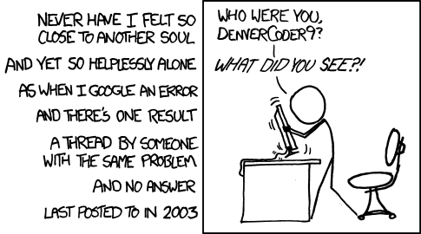
Sometime later…
Notes:
Call out xkcd
Future self
Callback to this later

Slide 4


How can your project help this person?
Notes:
What can you do `now` to help this future person?

Slide 5





Who This Talk Is For
Notes:
Who this talk is for: - People who are doing their own personal, hobby projects
- Academics doing research
- People doing open source work More broadly, it’s for:
- People who don't have a budget
- People who would like their work to live on and be useful to others

Slide 6
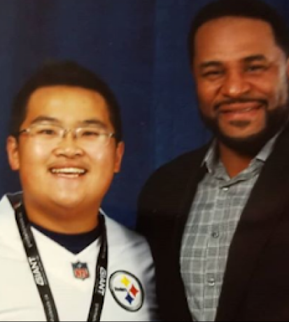

About Me
Self-taught R: hobbyist football analysis
Led to a data science career
Maintain public NFL data & nflverse/ffverse R packages
Notes:
This topic is near and dear to my heart for many reasons. I taught myself R doing fantasy football analysis while escaping from a job that I hated.

Slide 7

ffopportunity
Uses NFL play by play data
Expected Fantasy Points
Measures the value of player opportunities in fantasy football
github.com/ffverse/ffopportunity

Slide 8
Imports nflverse play by play data
Wrangles some features
Trains an xgboost model
Predicts fantasy points
…now what?

Slide 9

How can I make ffopportunity live on?
Can someone use (and improve on) my model?
Can new predictions be automated every week?
Where can I make predictions accessible?

Slide 10


Can someone use (and improve on) my model?

Slide 11
Make It a Package
Not (necessarily) for CRAN
Add a DESCRIPTION
Wrap code in functions

Slide 12
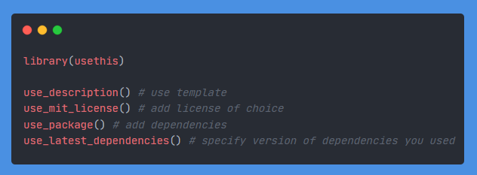
Add a DESCRIPTION
Specifies a LICENSE
Easy dependency install
usethis does everything!

Slide 13
Wrap logic into functions
Convert hardcoded variables to arguments
(Ctrl-Alt-X ⚡)
Add some usage notes
Goal: Make it easy for users to run

Slide 14

Can new predictions be automated every week?

Slide 15
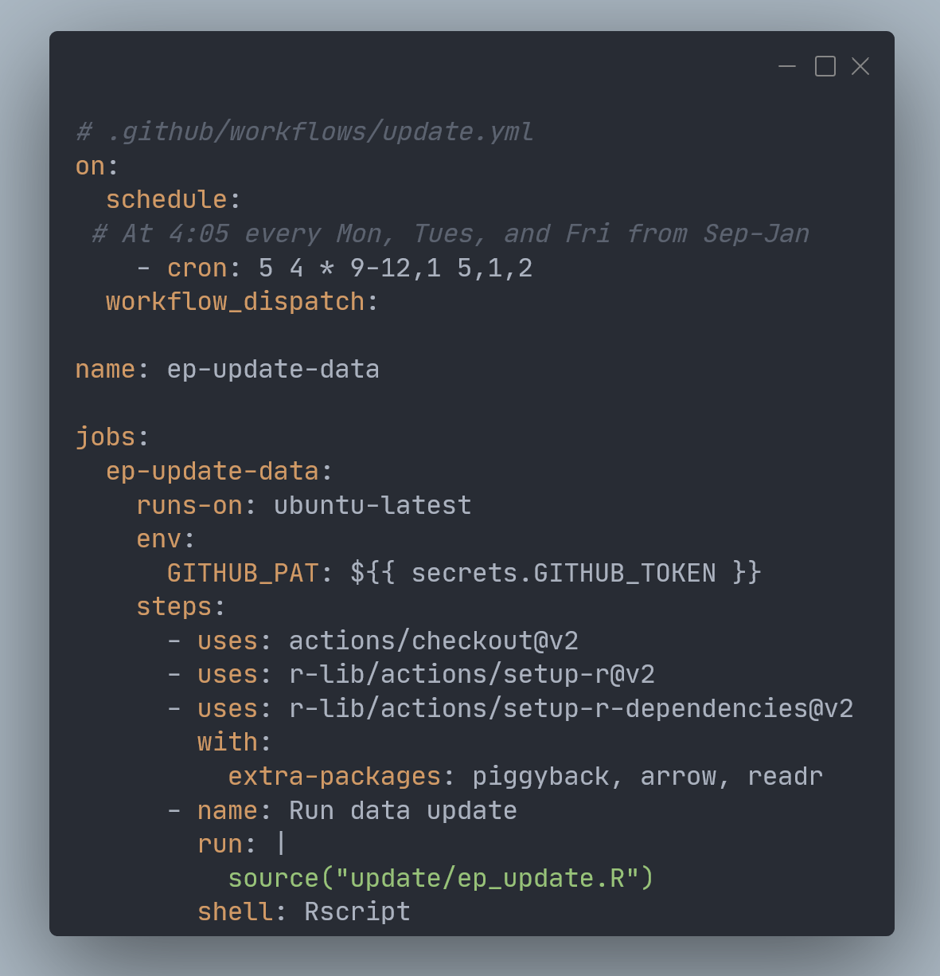
Automate Predictions with GitHub Actions

Slide 16

Where can I make predictions accessible?

Slide 17
Three Common Problems with GitHub Data Repositories
File Size Limits
Inefficient binary data storage
Commit history chaos

Slide 18

GitHub File Size Limits
75MB per file
2GB per repo

Slide 19
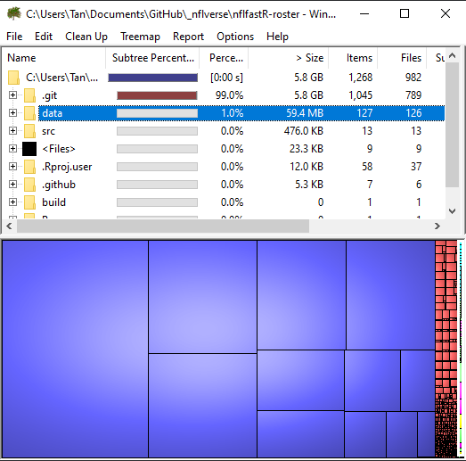
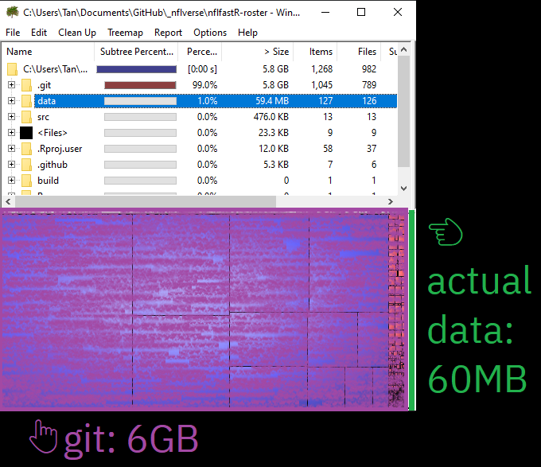
Version control is bad at binary files!

Slide 20
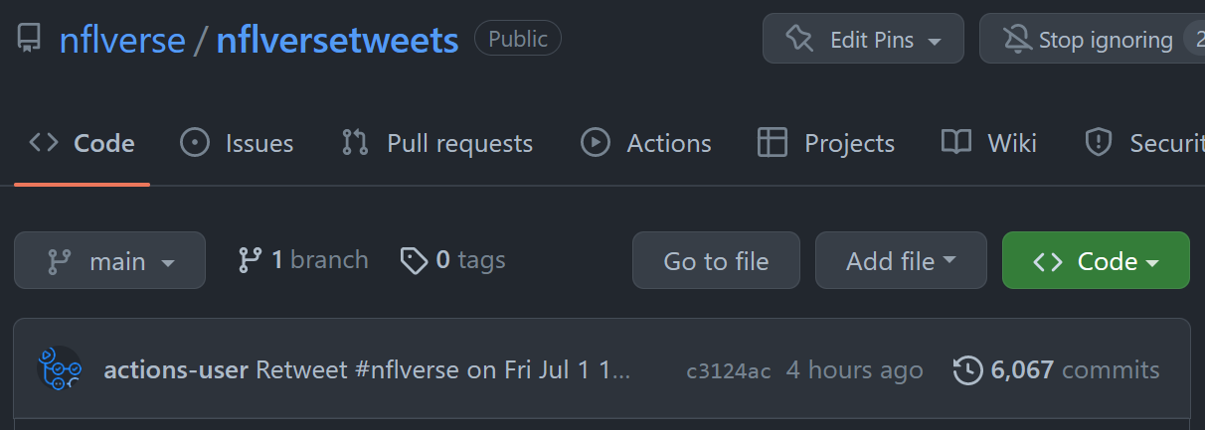
GitHub Data Repo Problems: Commit History Chaos!

Slide 21

Meh Solutions
Git Large File Storage (LFS) 😬
Amazon S3 buckets 💸
Dropbox 🤷‍♂️

Slide 22

Better Solution
GitHub Releases!

Slide 23
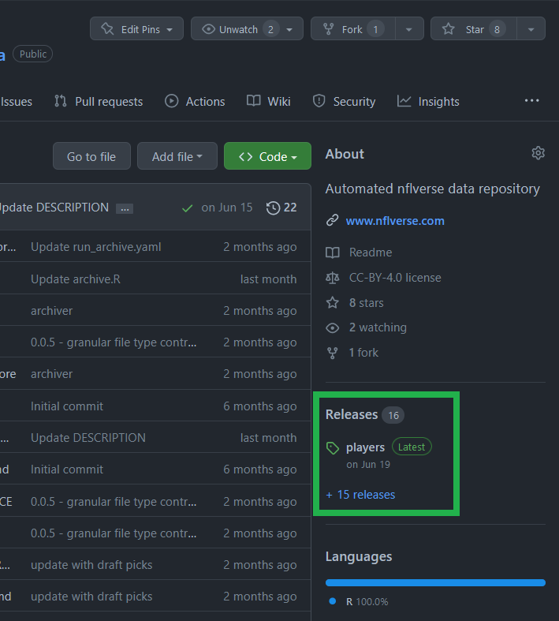
GitHub Releases
Make a new release
Upload files
Update as desired

Slide 24

GitHub Releases
Friendly file size limits
Versioning by choice
Keeps commit history clean
Data stays with your project
Free!

Slide 25
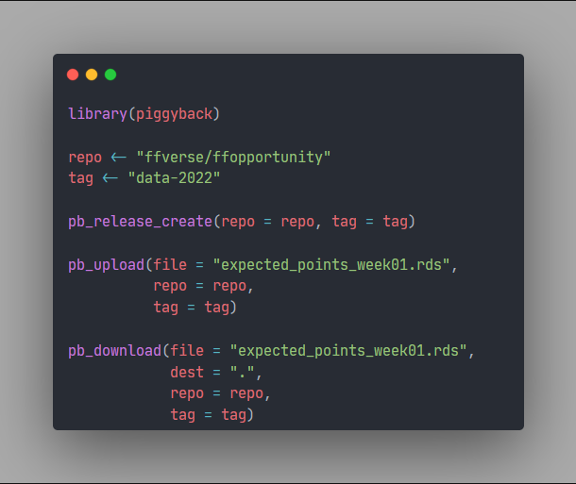

{piggyback}
Notes:
library(piggyback)
repo <- "ffverse/ffopportunity"
tag <- "data-2022"
pb_release_create(repo = repo, tag = tag)
pb_upload(file = "expected_points_week01.rds",
repo = repo,
tag = tag)
pb_download(file = "expected_points_week01.rds",
dest = ".",
repo = repo,
tag = tag)

Slide 26
Recap
How can my project help someone after I’ve moved on from it?

Slide 27

Project Immortality With GitHub
GitHub-hosted package
GitHub Actions
GitHub Releases
Store data with your project
Automation
Install, run, license

Slide 28

Thank you!

Slide 29
Resources
Packages
R Packages book https://r-pkgs.org
GitHub Actions
r-lib/actions https://github.com/r-lib/actions/
GHA with R book https://orchid00.github.io/actions_sandbox/
GitHub Releases
piggyback pkg https://github.com/ropensci/piggyback
ffopportunity https://github.com/ffverse/ffopportunity

